Slide 1
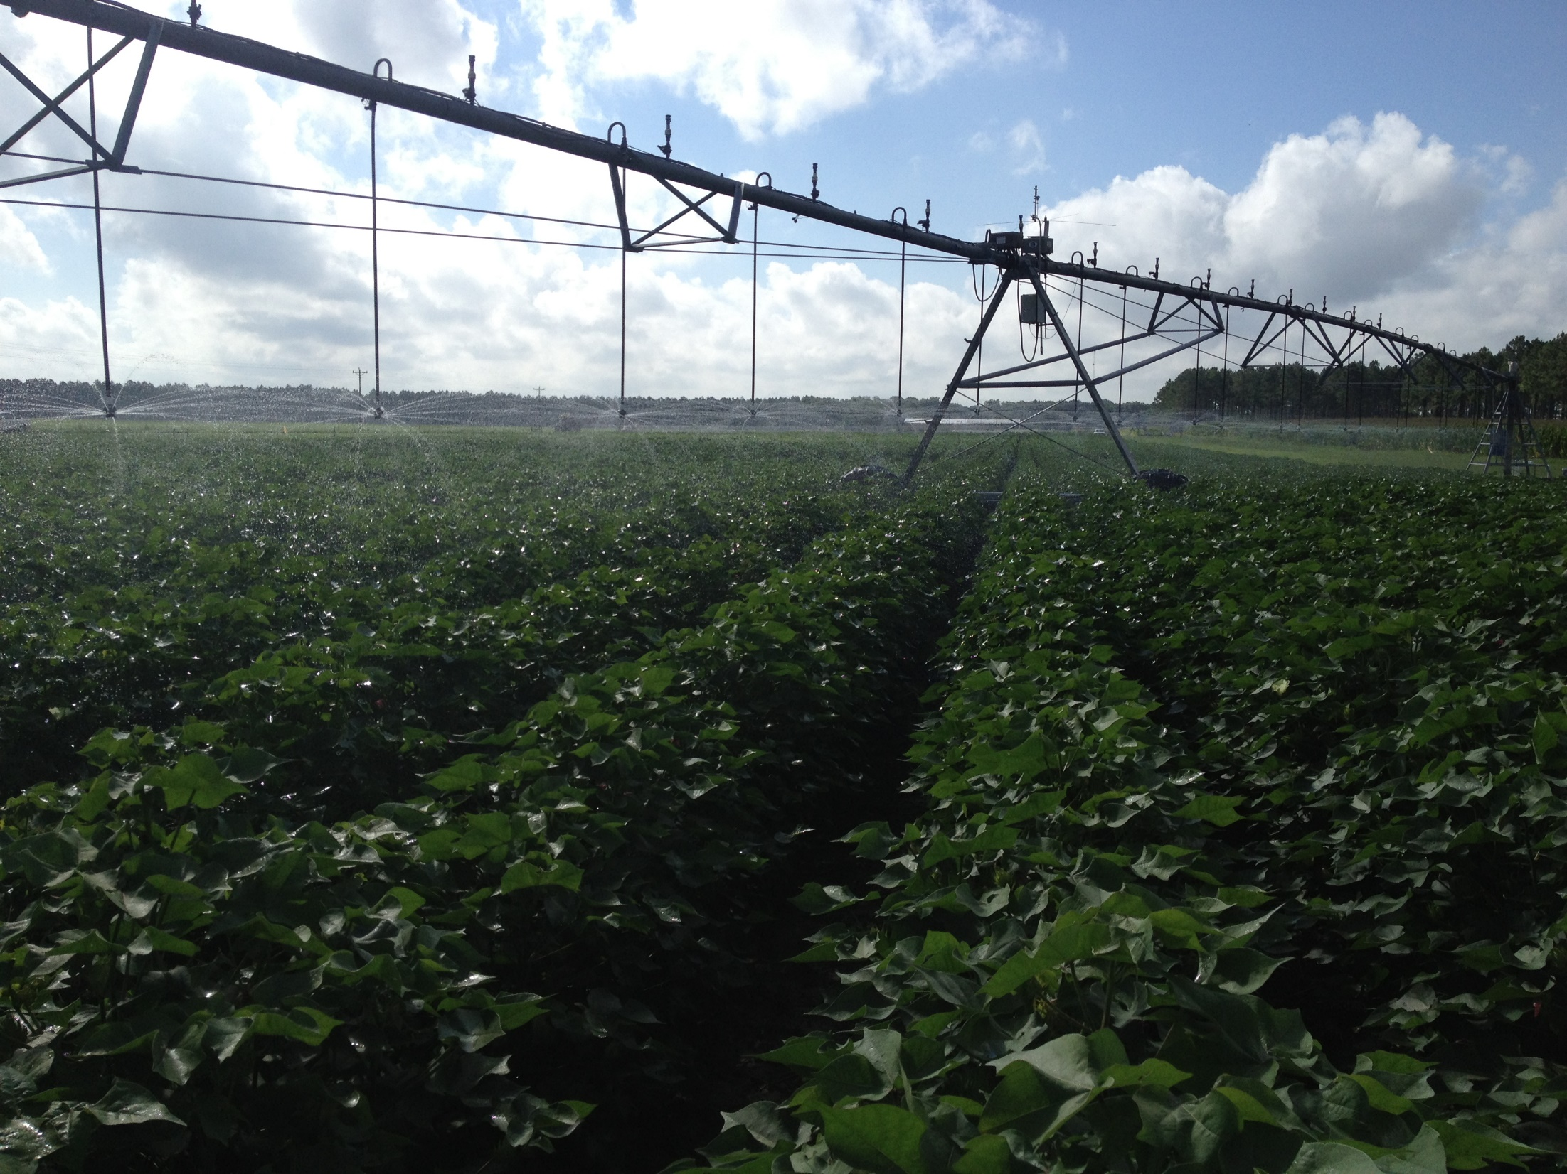
National Center for Alluvial Aquifer Research SWMRU Seminar
Daryl Chastain
^{Plant Physiologist}
^{USDA SWMRU}

Slide 2

About Myself
About Myself
Born in Arkansas
  Fort Smith
Married in 2006
  One daughter
  One son
Live in Greenville

Slide 3
About Myself
About Myself
Bachelor of Science, Biology 2009
  University of Central Arkansas
Mater of Science, Biology 2012
  University of Central Arkansas
  Research
    Heat tolerance in cotton (Hall et al., 2014)
    Field, growth-chamber, greenhouse

Slide 4
About Myself
PhD Crop and Soil Science
  University of Georgia, Crop and Soil Sciences, 2015
  Drought Research in Cotton
    Physiological response - Chastain et al., 2014
    Agronomic response – Chastain et al., 2016
    Plant-based irrigation scheduling - Chastain et al., 2016
    Leaf development/Heat tolerance- Snider et al., 2014; Chastain et al., 2016

Slide 5
Drought Response Modeling of Leaf Photosynthetic Parameters in Two Gossypium Species

Slide 6
Background
Measurement | Trend
Photosynthesis | ↓
R_{D}/P_{G} | ↑
g_{s} , E | ↓
Canopy Temperature | ↑
PS_{II} | =
Photorespiration | ↑
Lint Yield | ↓
How do underlying physiological mechanisms interact to decrease source strength and drive yield loss in upland cotton?
No cultivar differences
Still debate on energy capture
Chastain, D.R., Snider, J.L., Collins, G.D., Perry, C.D., Whitaker, J. and Byrd, S.A., 2014. Water deficit in field-grown Gossypium hirsutum primarily limits net photosynthesis by decreasing stomatal conductance, increasing photorespiration, and increasing the ratio of dark respiration to gross photosynthesis. Journal of Plant Physiology, 171(17), pp.1576-1585.

Slide 7
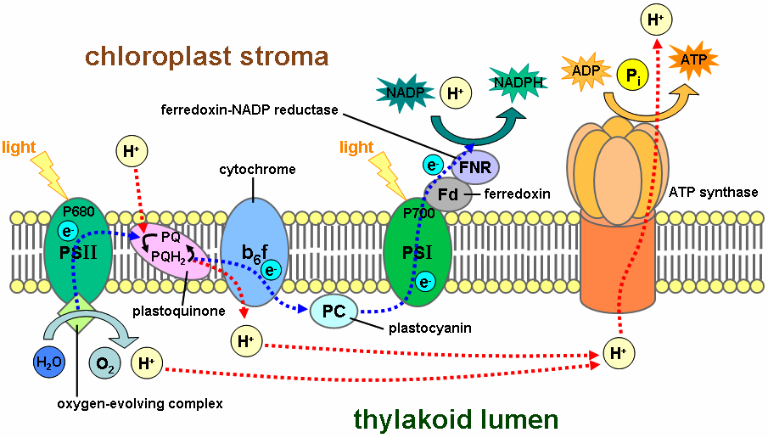
Background
How do underlying physiological mechanisms interact to decrease source strength and drive yield loss in upland cotton?
Still debate on stomatal vs non-stomatal limitations under drought.
Chastain, D.R., Snider, J.L., Collins, G.D., Perry, C.D., Whitaker, J. and Byrd, S.A., 2014. Water deficit in field-grown Gossypium hirsutum primarily limits net photosynthesis by decreasing stomatal conductance, increasing photorespiration, and increasing the ratio of dark respiration to gross photosynthesis. Journal of Plant Physiology, 171(17), pp.1576-1585.

Slide 8
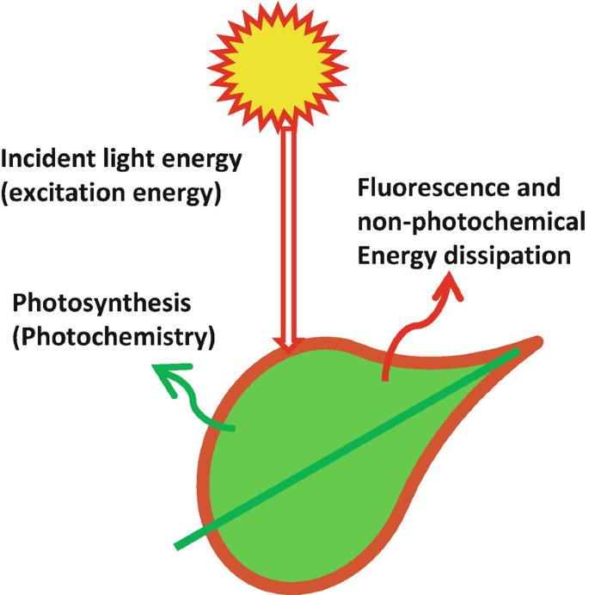
Background
Can we exploit fluorescence as a stress indicator?
Are any common parameters relatable to water stress?
Can we use other parameters to calibrate other RS methods
Advances in Plant Ecophysiology Techniques, 2018
ISBN : 978-3-319-93232-3
Amarendra Narayan Mishra

Slide 9
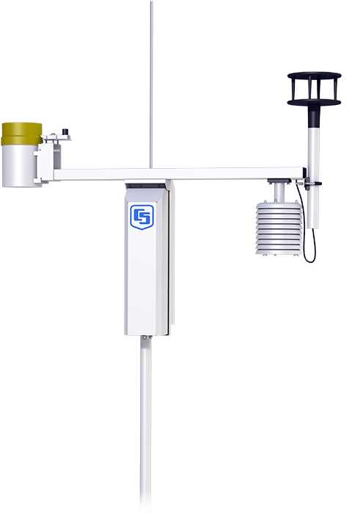
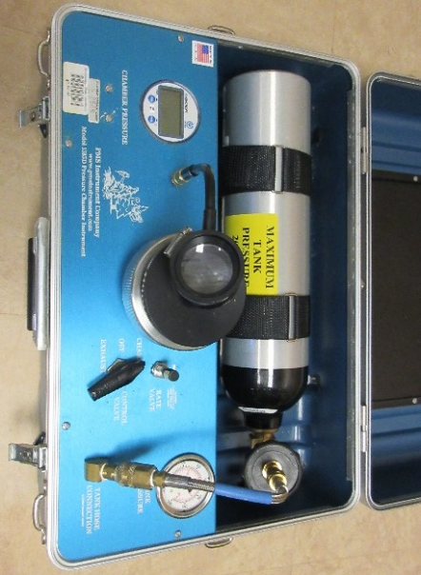
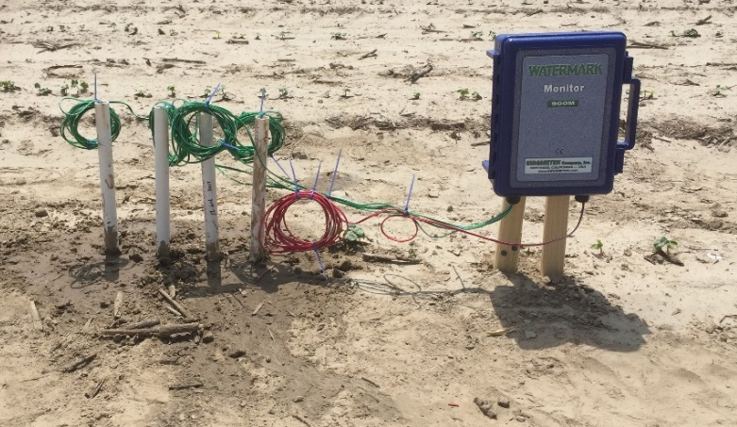
Typical Equipment
Environmental Data
Pressure chambers
  Provides leaf Ψ
Soil moisture/temperature
  Provides soil Ψ
ET weather stations
  15 minute ET, rainfall, temp, wind, light

Slide 10
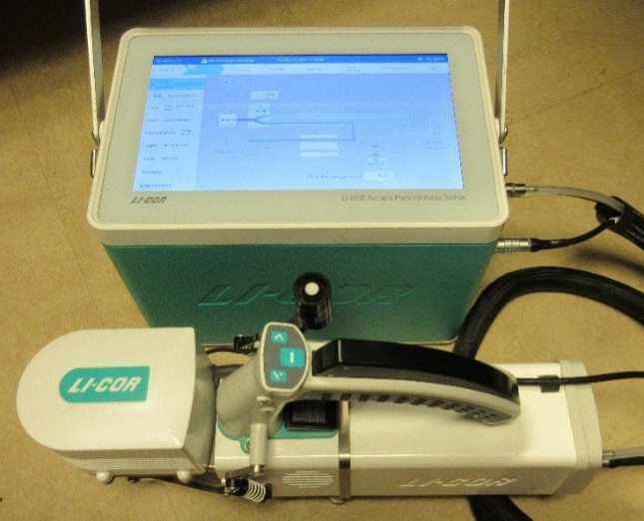
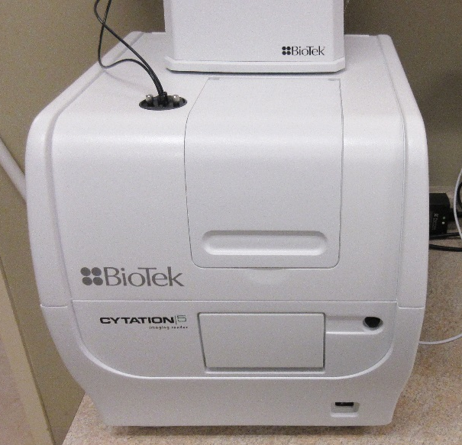
Typical Equipment
Photosynthesis system
P_{N} P_{G} R_{D} g_{s} E
CO₂ and Light Response
Chlorophyll Fluorescence
Multi-Mode Plate Reader
Pigments
Antioxidant Capacity
ATP Quantification

Slide 11
The Problem
nemaplex.ucdavis.edu
nemaplex.ucdavis.edu
There is a need for more data
Traditional A-C_{i} Response
A_{c} used to estimate V_{cmax}
A_{j} used to estimate J_{max}
Very time consuming
~35-50 minutes

Slide 12
The Problem
nemaplex.ucdavis.edu
nemaplex.ucdavis.edu
Rapid A-C_{i} Response
A_{c} used to estimate V_{cmax}
A_{j} used to estimate J_{max}
Less time consuming
~10 minutes
Way more data
See Stinziano et al., 2017

Slide 13
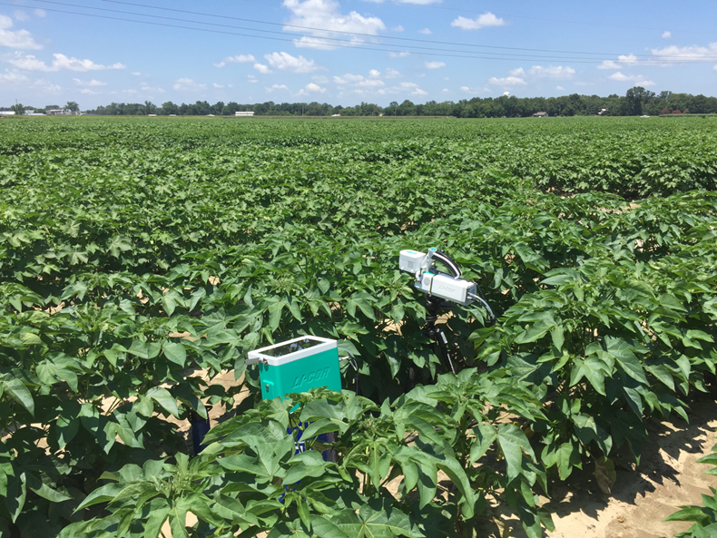
Experiments
nemaplex.ucdavis.edu
nemaplex.ucdavis.edu
Two Gossypium species
  PHY490 WRF (Gossypium hirsutum)
  PHY881 RF (Gossypium barbadense)
Well-watered until flowering
Daily gas exchange and water status

Slide 14
Results
nemaplex.ucdavis.edu
nemaplex.ucdavis.edu
64 curves
~ 48 hours using traditional A/C_{i}
~7 hours using RACiR

Slide 15
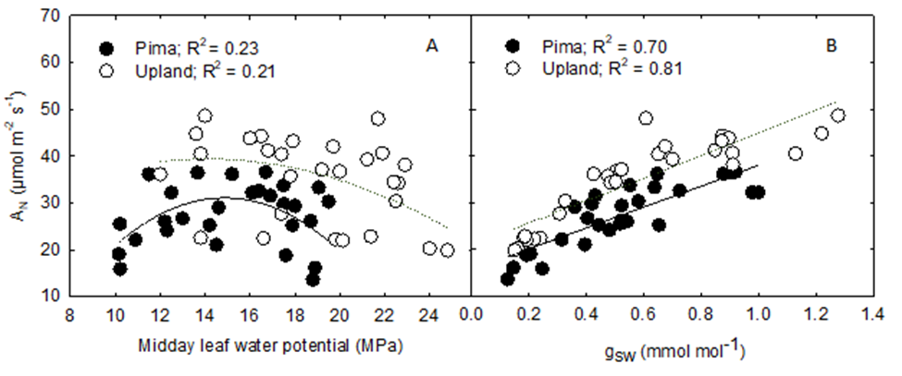
Results
nemaplex.ucdavis.edu
nemaplex.ucdavis.edu
What metric should we use to assess water-stress?

Slide 16
Results
nemaplex.ucdavis.edu
nemaplex.ucdavis.edu
Mild Drought
Stomatal conductance x A
No relationship for any parameter related to energy capture
Strong relationship with C_{i}

Slide 17
Results
nemaplex.ucdavis.edu
nemaplex.ucdavis.edu
Where does the excess energy go?
In upland cotton, the excess is consumed in photorespiration and NPQ (heat)
F_{S} shows strong potential as a stress indicator
Not clear for pima

Slide 18
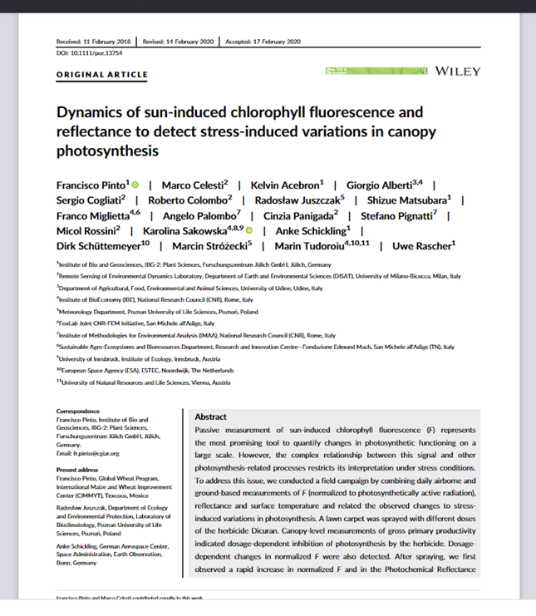
Results
nemaplex.ucdavis.edu
nemaplex.ucdavis.edu
Sun induced fluorescence
  Rapid stress assessment
Spectroradiometry
  More useful in lower light
Proximal sensing
  Critical for calibration of remote sensing
Our rate of data collection is rapidly increasing

Slide 19
Questions?

